Slide 1


Green Pace
Security Policy Presentation
Developer: Marco Aldana

Slide 2

OVERVIEW: DEFENSE IN DEPTH

Slide 3
THREATS MATRIX
Likely STD-002-CPP STD-007-CPP | Priority STD-004-CPP STD-005-CPP
Low priority STD-008-CPP | Unlikely STD-001-CPP STD-003-CPP STD-006-CPP STD-009-CPP STD-010-CPP

Slide 4
10 PRINCIPLES
Validate Input Data
Data Type, Data Value, SQL Injection
Heed Compiler Warnings
Memory Protection, Exceptions
Architect and Design for Security Policies
SQL Injection, Cyclomatic Complexity
Keep it Simple
Data Type, Cyclomatic Complexity
Default Deny
Adhere to the Principle of Least Privilege
Sanitize Data Sent to Other Systems
String Correctness
Practice Defense in Depth
Use Effective Quality Assurance Techniques
Assertions
Adopt a Secure Coding Standard
Declaration and Initializations, Object Oriented Programming

Slide 5
CODING STANDARDS
Data Type
Severity: Medium
Likelihood: Unlikely
Remediation Cost: Medium
Priority: P4, Level: L3
Data Value
Severity: Medium
Likelihood: Likely
Remediation Cost: Medium
Priority: P4, Level: L3
String Correctness
Severity: Medium
Likelihood: Unlikely,
Remediation Cost: Medium
Priority: P4, Level: L3
SQL Injection
Severity: High,
Likelihood: Priority
Remediation Cost: Medium
Priority: P12, Level: L1
Memory Protection
Severity: High
Likelihood: Priority,
Remediation Cost: High,
Priority: P6, Level: L2
Assertions
Severity: Low
Likelihood: Unlikely
Remediation Cost: Low
Priority: P1, Level: L3
Exceptions
Severity: High
Likelihood: Likely
Remediation Cost: High
Priority: P9, Level: L2
Cyclomatic Complexity
Severity: Medium
Likelihood: Low Priority
Remediation Cost: Medium
Priority: P8, Level: L2
Declarations and Initializations
Severity: High
Likelihood: Unlikely
Remediation Cost: Medium
Priority: P6, Level: L2
Object Oriented Programming
Severity: Medium
Likelihood: Unlikely
Remediation Cost: Medium
Priority: P4, Level: L3

Slide 6
ENCRYPTION POLICIES
Three different types of Encryption Policies:
Encryption in Rest
Designed to prevent the attacker from accessing unencrypted data.
Ensures data is encrypted when on the disk
Examples: Passwords, sensitive personal records
Encryption at Flight
Designed to encrypt the data during transmission over a network
Keeps data secure in the event of a network injection attack
Encryption in Use
Combination of both in Rest and at Flight
Designed to ensure sensitive data is never left unsecured

Slide 7
TRIPLE-A POLICIES
Authentication
Allows a user to be identified
Traditional means include username/password combination
Can be enforced using challenge questions to verify a users identity
Authorization
Grants users the ability to perform a certain task
Granted access can include accessing secure files, executing stored procedures or queries, anything necessary for elevated privileges
Accounting
Measures the resources a user consumes during access
Can include logging actions that a user performs
Capturing anomalies or errors

Slide 8
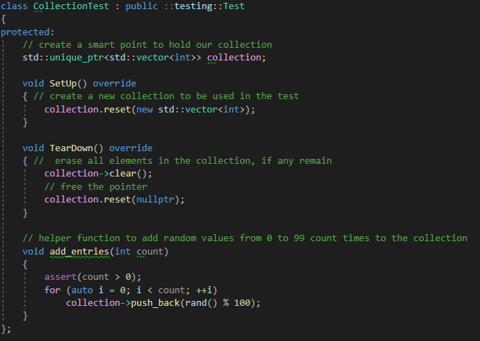
Unit Testing – Memory Allocation
Setup work – Create functions to setup, tear down and add entries to a collection vector

Slide 9
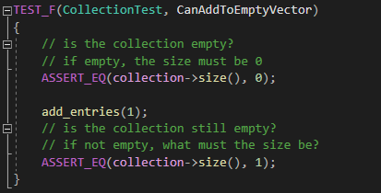
Unit Testing – Memory Allocation
Positive Test 1 – Verify that an empty vector can be added to using the push_back function on the standard vector libarary

Slide 10
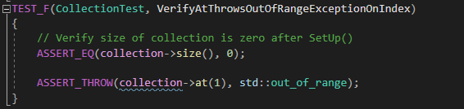
Unit Testing – Memory Allocation
Negative Test 1 – Assert that attempting to access an element outside of the collection’s current index max using the at() function throws an out_of_range exception

Slide 11
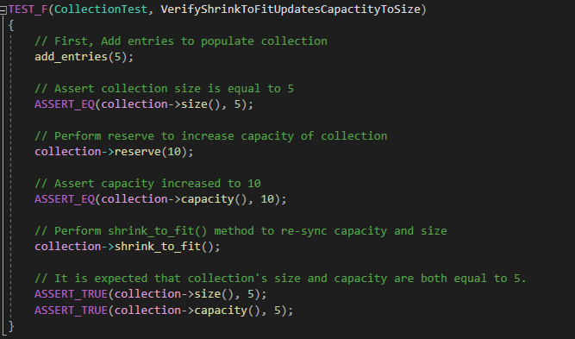
Unit Testing – Memory Allocation
Positive Test 2 – Verify that the shrink_to_fit() function on the vector re-allocates the capacity to the current size of the vector

Slide 12
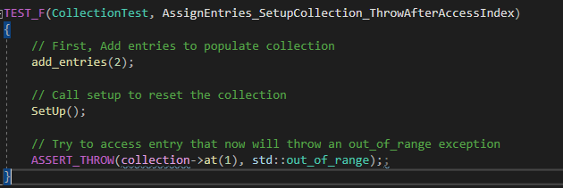
Unit Testing – Memory Allocation
Negative Test 2 – Verify that adding entries, then wiping the vector, and attempting to access an element that was previously there throws an out_of_range exception

Slide 13

AUTOMATION SUMMARY

Slide 14
RISKS AND BENEFITS
Risks of not addressing security iteratively
Potential of pushing up security vulnerabilities into production
Reputation at risk
Potential to be costly to remediate
No standards or policies followed
Benefits of not addressing security iteratively
Overall speed of development
The risks outweigh the benefits. Security should be applied iteratively and continuously!

Slide 15
RECOMMENDATIONS
Introduction of Automation Regression Tests into the DevSecOps pipeline.
Quickly perform regression tests if the application is data driven to perform set calculations.
Create standard for tools
This policy introduced a few tools per the CERT C++ Guidelines, Green Pace should consolidate these into a smaller subgroup to remain cost efficient
Verify Code Dependencies
Approximately 96% of applications within a test group of 1,000 companies relied on external, open-source dependencies within their application. These should be verified if the open-source dependency is altered in a way that alters inherent behavior of the calling application.

Slide 16
CONCLUSIONS
Security should be considered at all stages of the applications life cycle
Continuous and evolving
Using the Security principles and Coding standards within this guide, Green Pace will have a solid foundation of keeping their applications secure
This is not intended to be a full-proof guide to cover all aspects of vulnerabilities
Threats evolve and so should the practices to prevent them
A solid defense in depth strategy is aware of the potential vulnerabilities and adequately covers them with multiple defense approaches

Slide 17
REFERENCES
“5 Top Tips to Improve YOUR Devsecops Practices.” Kiuwan, 6 July 2021, www.kiuwan.com/5-top-tips-to-improve-your-devsecops-practices/.
“Assertions.” DCL03-C. Use a Static Assertion to Test the Value of a Constant Expression - SEI CERT C Coding Standard - Confluence, wiki.sei.cmu.edu/confluence/display/c/DCL03-C.+Use+a+static+assertion+to+test+the+value+of+a+constant+expression.
“CERT C++: Data Validation.” EXP58-CPP. Pass an Object of the Correct Type to va_start - SEI CERT C++ Coding Standard - Confluence, wiki.sei.cmu.edu/confluence/display/cplusplus/EXP58-CPP.+Pass+an+object+of+the+correct+type+to+va_start.
“CERT C++: String Correctness.” ERR62-CPP. Detect Errors When Converting a String to a Number - SEI CERT C++ Coding Standard - Confluence, wiki.sei.cmu.edu/confluence/display/cplusplus/ERR62-CPP.+Detect+errors+when+converting+a+string+to+a+number.
Contributor, TechTarget. “What Is Authentication, Authorization, and Accounting (AAA)? - Definition from Whatis.com.” SearchSecurity, TechTarget, 16 Nov. 2010, searchsecurity.techtarget.com/definition/authentication-authorization-and-accounting.

Slide 18
REFERENCES Part 2
“Cyclomatic Complexity.” EXP50-CPP. Do Not Depend on the Order of Evaluation for Side Effects - SEI CERT C++ Coding Standard - Confluence, wiki.sei.cmu.edu/confluence/display/cplusplus/EXP50-CPP.+Do+not+depend+on+the+order+of+evaluation+for+side+effects.
“Data Privacy and Security.” Quantum Metric, 9 July 2021, www.quantummetric.com/platform-foundations/data-privacy-security/.
“Exceptions.” ERR56-CPP. Guarantee Exception Safety - SEI CERT C++ Coding Standard - Confluence, wiki.sei.cmu.edu/confluence/display/cplusplus/ERR56-CPP.+Guarantee+exception+safety.
“Memory Allocation.” MEM35-C. Allocate Sufficient Memory for an Object - SEI CERT C Coding Standard - Confluence, wiki.sei.cmu.edu/confluence/display/c/MEM35-C.+Allocate+sufficient+memory+for+an+object.
Msmbaldwin. “Azure Data Encryption-at-Rest - Azure Security.” Azure Data Encryption-at-Rest - Azure Security | Microsoft Docs, docs.microsoft.com/en-us/azure/security/fundamentals/encryption-atrest#:~:text=Encryption%20at%20rest%20is%20designed,encryption%20to%20read%20the%20data.
“Namespaces.” DCL58-CPP. Do Not Modify the Standard Namespaces - SEI CERT C++ Coding Standard - Confluence, wiki.sei.cmu.edu/confluence/display/cplusplus/DCL58-CPP.+Do+not+modify+the+standard+namespaces.
“Object-Oriented Programming.” OOP53-CPP. Write Constructor Member Initializers in the Canonical Order - SEI CERT C++ Coding Standard - Confluence, wiki.sei.cmu.edu/confluence/display/cplusplus/OOP53-CPP.+Write+constructor+member+initializers+in+the+canonical+order.
“SQL Injection.” IDS00-J. Prevent SQL Injection - SEI CERT Oracle Coding Standard for Java - Confluence, wiki.sei.cmu.edu/confluence/display/java/IDS00-J.+Prevent+SQL+injection.

